Slide 1
4.2 Types of programming languages, translators and IDEs
Assembly language

Slide 2
Evolution of computer languages
OO and visual languages
OO and visual languages
High-level languages
High-level language
(Fortran, C, Pascal)
High-level language
(Fortran, C, Pascal)
Assembly language
Low-level languages
Machine language
Hardware
Hardware
Notes:
-

Slide 3

What is assembly language?
The very first languages such as ENIAC (1946) were direct machine code languages that required programmers to enter binary combinations of 1s and 0s.

Slide 4
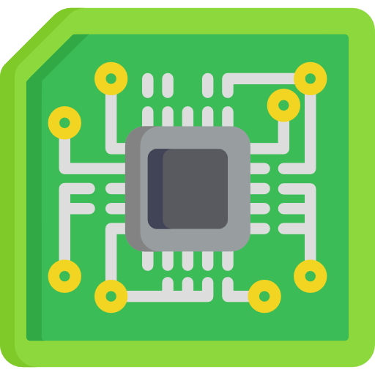

Machine-code language and assembly language
1001101000111100
Machine-code language
Least abstract.
Closest to what actually happens on a computer.
Programming directly in 1s and 0s.
These translate directly into matching electrical signals – e.g., 1 for high voltage and 0 for low voltage.
OO and visual languages
HLL
High-level language
(Fortran, C, Pascal)
Assembly language
LLL
Machine language
Hardware
Notes:
-

Slide 5
What is assembly language?
These languages were incredibly difficult to program with, leading to the creation of assembly languages.
Assembly languages substituted binary code with simple sequences of letters known as mnemonics.
All assembly languages are classified as low-level languages.
OO and visual languages
HLL
High-level language
(Fortran, C, Pascal)
Assembly language
LLL
Machine language
Hardware

Slide 6


Machine-code language and assembly language
Instruction table
ADD | 11001001
SUB | 01010010
MULT | 10010001
DIV | 01101010
COMP | 00011001
Memory table
NUM1 | 100100101
NUM2 | 010101100
TOT | 110010001
ADD NUM 1
11001001100100101
Assembly language
Programming using short-code words known as mnemonics.
The mnemonic is received by the computer and looked up in tables.
If a match is found, the word is replaced with a sequence of binary 1s and 0s.
One-to-one relationship.
Written in assembly language and translated by a specific assembler.
OO and visual languages
HLL
High-level language
(Fortran, C, Pascal)
Assembly language
LLL
Machine language
Hardware
Notes:
-

Slide 7

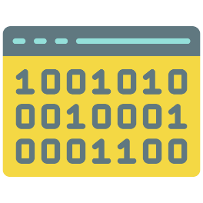
What is assembly language?
Assembly language is directly translated into binary machine code by an assembler.
INP
STA Num1
INP
ADD Num1
OUT
Num1 DAT
Low-level assembly code
Translator (assembler)
Machine code

Slide 8

Assembly language
Machine code
Binary representation of instructions in a format that the CPU can decode and execute.
Low-level languages
Written in assembly language.
A form of low-level language that uses mnemonics.
Mnemonics are abbreviations of operations, typically using short alphabet codes – e.g., LDA, STA, INP
Translated to an assembler into machine code.

Slide 9


